Slide 1
Movie Watching Group
Use case model

Slide 2
actors
moderator: group manager incharge of tasks such as: creating a group, invite people into group, create movie watching event, initiate and close voting.
group members: family members except the moderator, who can vote for the movies during movie watching events, search for movies, vote on movies and read movie comments.
movie review site: the site that provide reviews for each movie that can be accessed by the group members.

Slide 3
Use cases
login: login the movie watching system.
create movie group: create a group for new members.
pull a movie list: create a list of movie and add them into group.
inviting people: add more people into movie group.
create movie watching event: create a event and prepare for voting.
open voting: open the voting channel for group members and inform group members.
close voting: close voting and show movie winner.

Slide 4
Use cases
cast votes: vote for movie you like
join a group: join a group created by moderator.
unsubscribe from a group: leave a group that you have joined before.
search movie: search a movie by name.
check movie reviews: check movie reviews.
watch movie: you have option to watch trailer or whole movie.

Slide 5
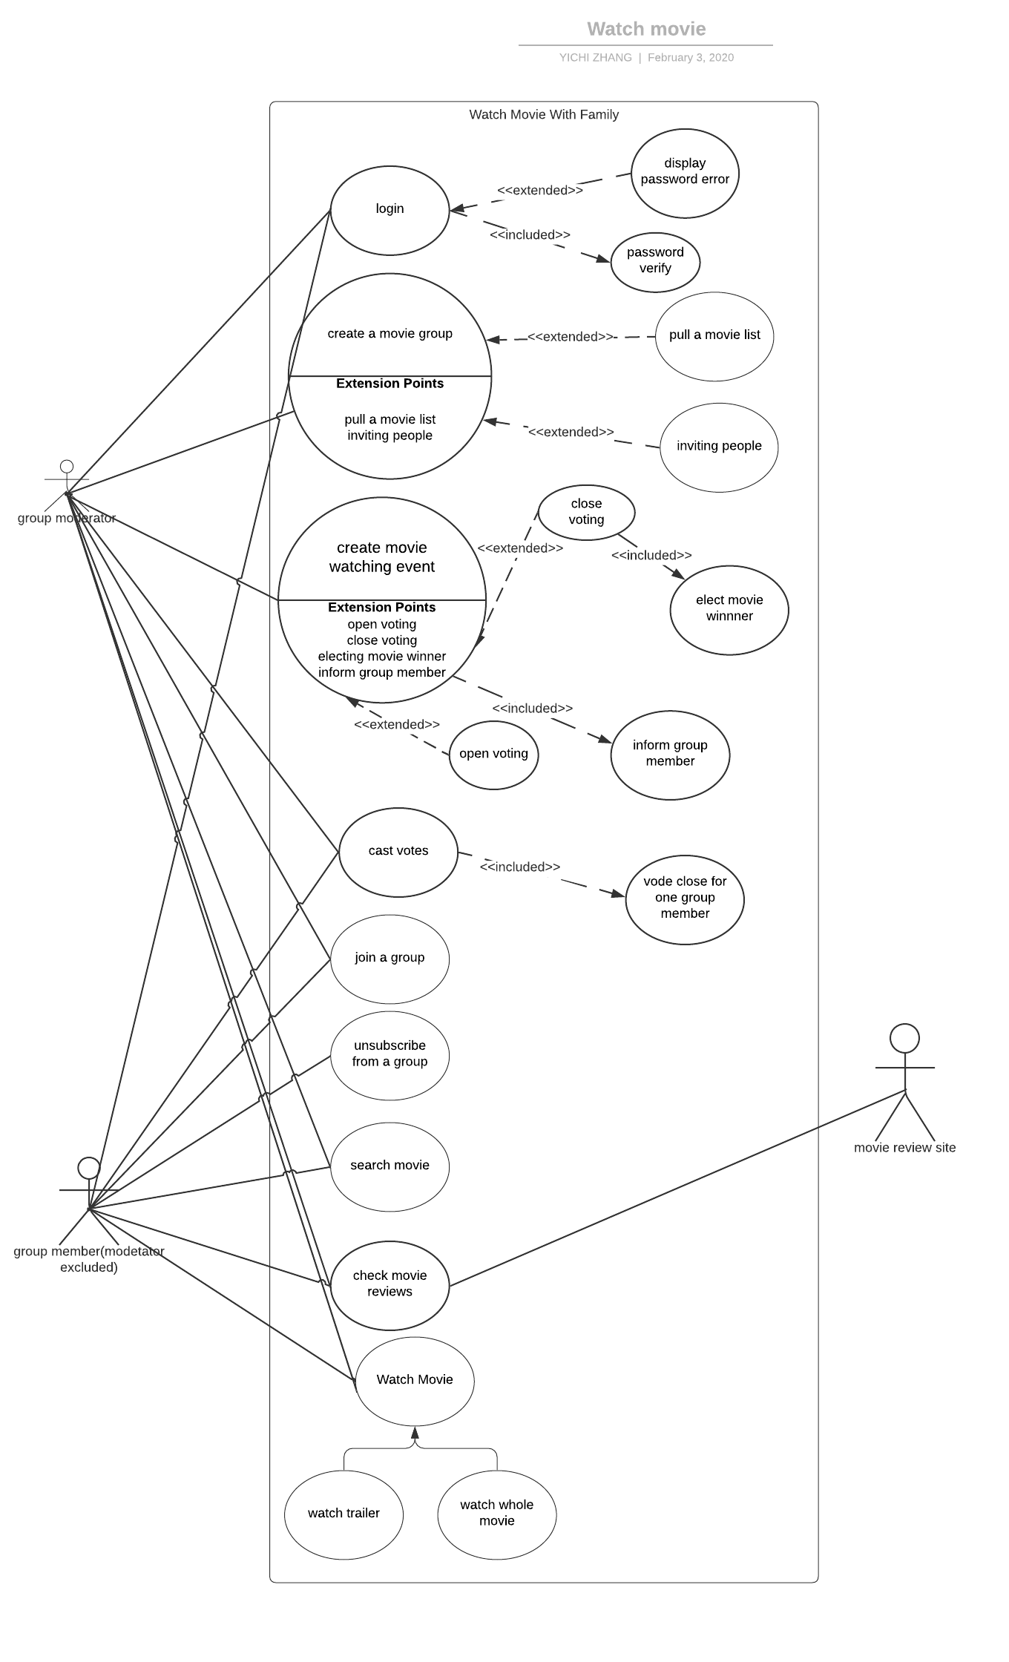
Diagrams

